Slide 1




PL/SQL
Examination
Hotel Management system
IWN
By IRABARUTA Willy Norbert 27463

Slide 2
INTRODUCTION
The project focuses on automating hotel operations through a robust PL/SQL-based database.
Built with Oracle 21c and Oracle SQL Developer.
Includes full backend logic: triggers, procedures, auditing, and transaction control.
Targeted for use in small to mid-sized hotels in Rwanda.

Slide 3
Manual hotel operations often lead to:
Double bookings and customer dissatisfaction
Poor record-keeping and data loss
Limited control over employee actions
Goal: Build a secure, efficient system to automate core hotel functions:
Room booking, payments, employee management
Enforced security policies
Real-time auditing
PROBLEM DEFINITION
Manual hotel operations often lead to:
Double bookings and customer dissatisfaction
Poor record-keeping and data loss
Limited control over employee actions
Goal: Build a secure, efficient system to automate core hotel functions:
Room booking, payments, employee management
Enforced security policies
Real-time auditing

Slide 4
METHODOLOGY & APPROACH
Database Design:
Logical & physical modeling (ERD, normalization to 3NF)
Entity examples: GUEST, EMPLOYEE, RESERVATION, PAYMENT, ROOM
PL/SQL Features:
Stored Procedures & Functions (e.g., Check availability, Register guest)
Cursors, Exception Handling
Packages for modular development
Security Implementation:
Restriction triggers for weekends/public holidays
Auditing system with AUDIT_LOG table

Slide 5
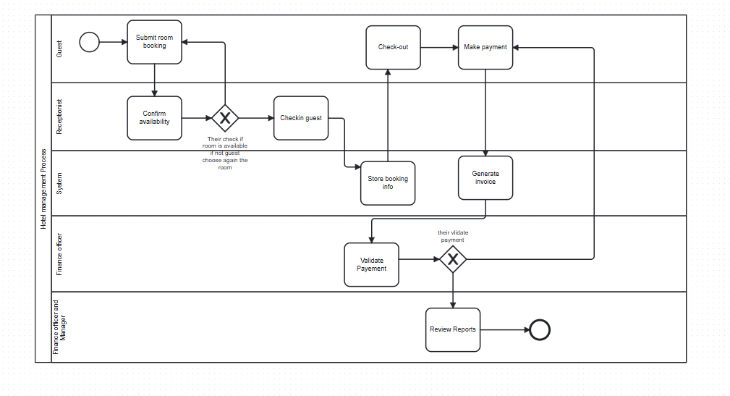
Models reservation flow from guest check-in to billing
Shows MIS alignment:
Supports decision-making
Tracks KPIs: room usage, staff actions
Enhances data traceability
BUSIINESS PROCESS DIAGRAMA
Models reservation flow from guest check-in to billing
Shows MIS alignment:
Supports decision-making
Tracks KPIs: room usage, staff actions
Enhances data traceability

Slide 6
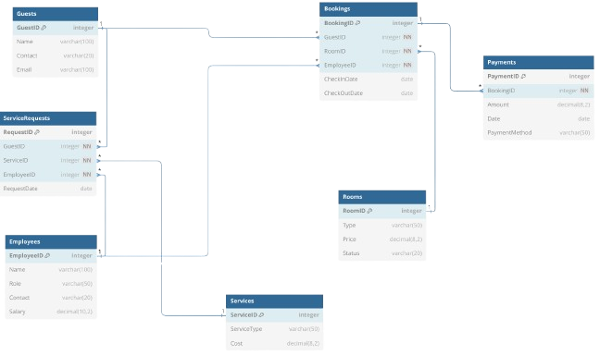
DATABASE STRUCTURE
Entities & Keys:
GUEST (guest_id PK), EMPLOYEE (emp_id PK), RESERVATION (FKs to guest & room)
Constraints:
NOT NULL, CHECK, FOREIGN KEY, UNIQUE

Slide 7
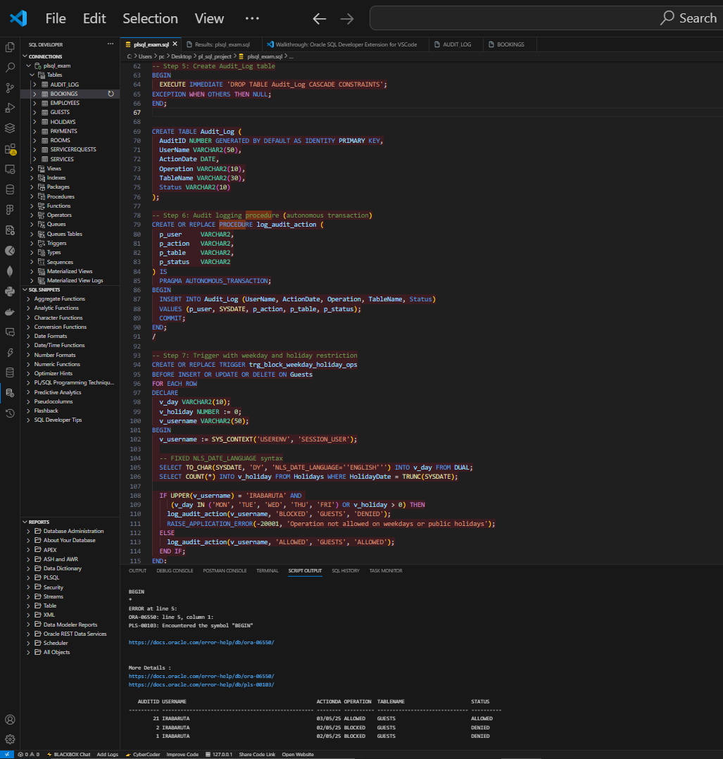
PRODEFURES, PACKAGES AND TRIGGERS
Procedures/Functions:
register_guest, process_payment, get_available_rooms
Compound Triggers:
Block operations on weekdays/public holidays using a HOLIDAY reference table
Packages:
Centralized logic for reservations and reports

Slide 8
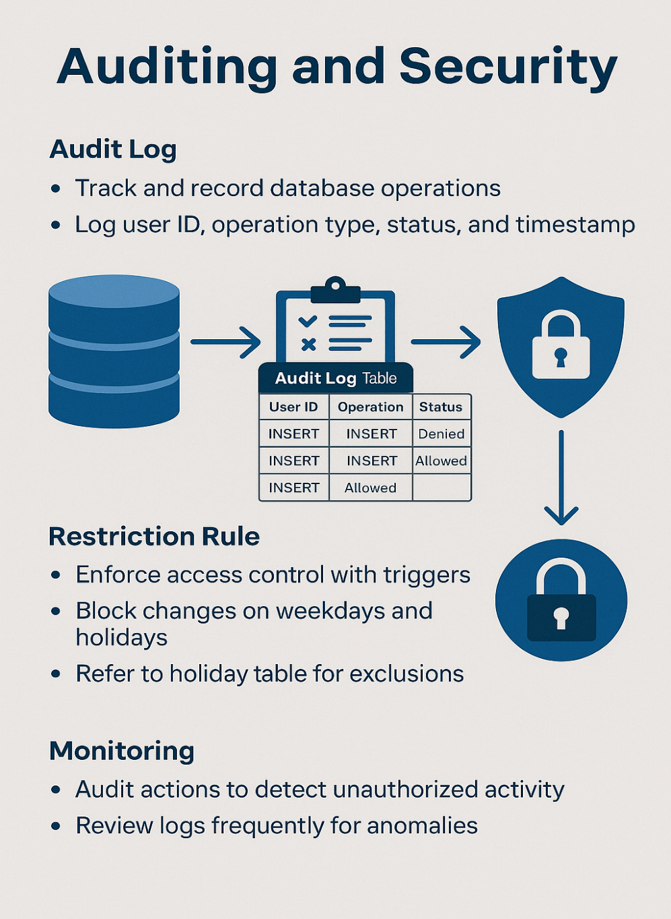
AUDITING ND SECURITY
Trigger-Based Auditing:
Logs each insert/update/delete in AUDIT_LOG
Audit Table Structure:
user_id, action_time, table_name, operation_type, status
Security Benefits:
Tracks unauthorized access attempts
Supports accountability and forensic tracking

Slide 9

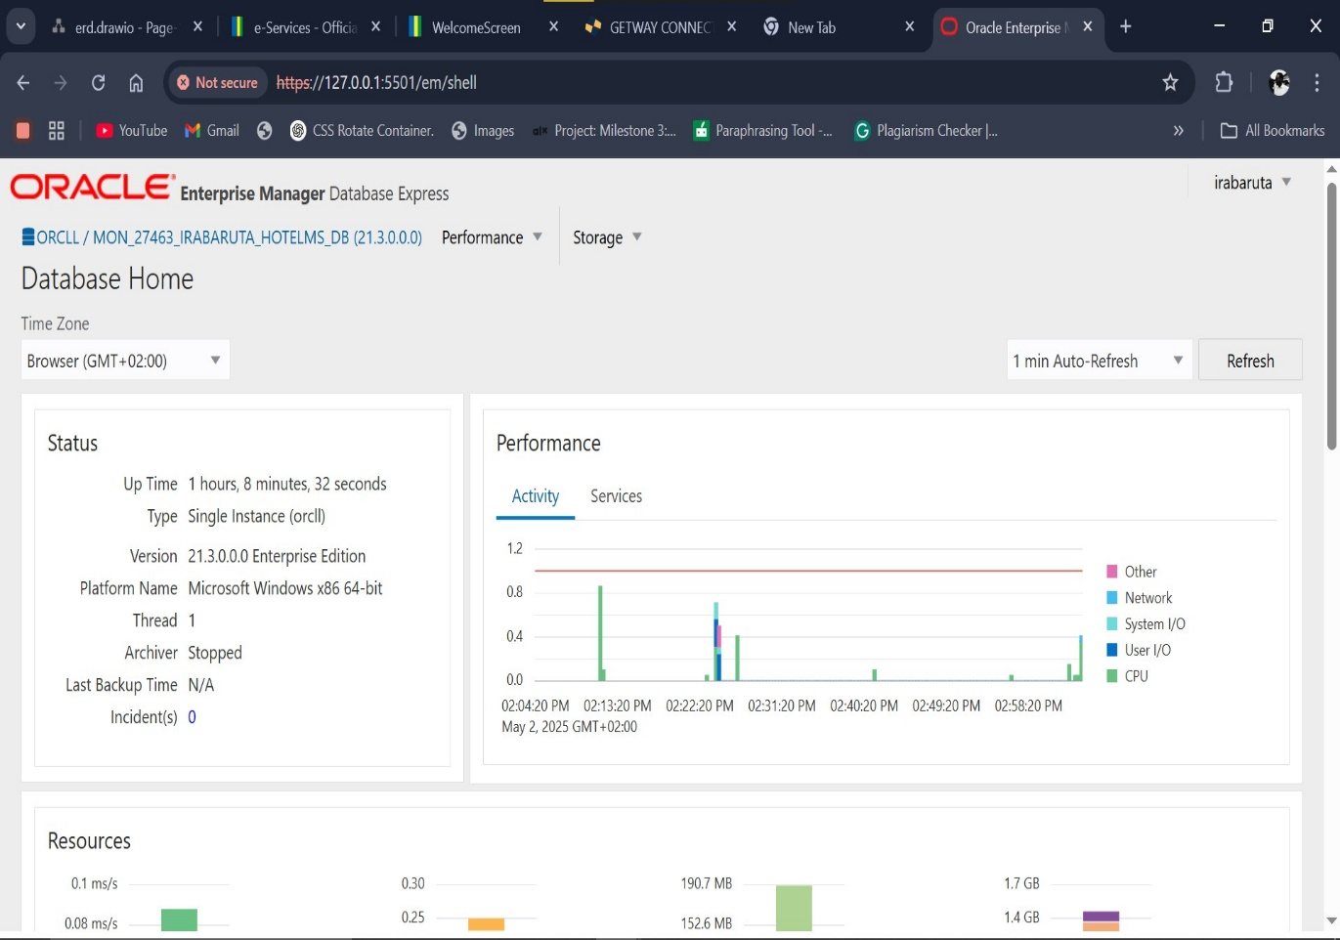
Successfully implemented:
Full CRUD functionality
Advanced PL/SQL logic
Secure manipulation rules
Effective MIS process support
Test Results:
Handled multiple booking scenarios
Holiday/weekend restrictions enforced correctly

Slide 10
Manual hotel operations often lead to:
Double bookings and customer dissatisfaction
Poor record-keeping and data loss
Limited control over employee actions
Goal: Build a secure, efficient system to automate core hotel functions:
Room booking, payments, employee management
Enforced security policies
Real-time auditing
CONCLUSION & FUTURE WORK
Conclusion:
The project met all course goals and solved real-world hotel problems
A secure and reliable hotel database system was built
Recommendations:
Create a mobile app for guests
Connect the system to online payment services
Future Work:
Improve access control based on user roles
Use machine learning to predict room prices and guest bookings

Slide 11
THANK
YOU

